Slide 1

Ballad: The Musician's Social Media
Project Proposal by
Team Triad
Members: Calvin Dupee, Henry Montesano III

Slide 2

App Philosophy / Overview
The best way for musicians to connect and create with other artists around the world!
Features:
Unique user profile containing details for instruments played, genres, location settings, ect.
Live Jam Session: Video-conferencing connecting musicians with different instruments to play together
Ability to save & export audio or video file of recording sessions with the cloud
In-app metronome & tuner
In-app music player to listen to saved sessions
In-app sheet music store

Slide 3



User Profile Example
Name: Larry Davis
Instruments: Guitar, Bass
Location: Las Vegas, Nevada
Genres: Rock, Jazz, Country
Skill Level: Intermediate
Purchased Sheet Music: "Take 5", "Ain't No Sunshine"

Slide 4

Live Jam Session
Connect to other app users around the world via audio or video call
Offers both servers & P-2-P setups for lower latency depending on speed
Find artists with similar genre interests, song choices, or sheet music using user's chosen parameters and in-app purchases
Integrated with Save & Export Video / Audio feature
Report System

Slide 5

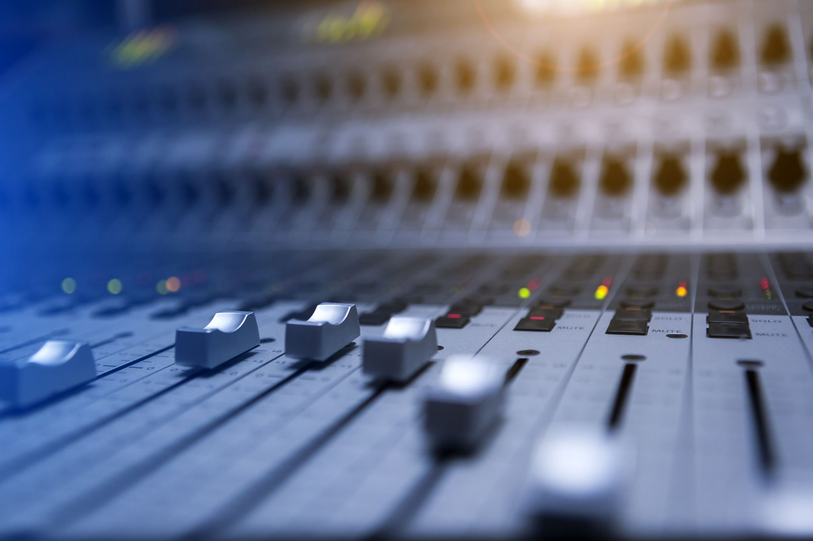


Save & Export Video/Audio
-Records session in real time
-Can record each person's audio for clarity
-Ability to save recording in multiple file types, Ex: Wav, MP3, Etc.
-Saves to cloud database or export to pc

Slide 6
Metronome & Tuner
Ability to use a metronome for timing purposes
Ability to choose the instrument and properly tune it

Slide 7

In-App Music Player
Listen to previous sessions
Can search for other users' public sessions

Slide 8
Sheet Music Store
Upload your own
Connect with other people who own the same
Search based on instruments

